Slide 1
2nd Place Solution
Instacart Market Basket Analysis

Slide 2
Agenda
My Background
Problem Overview
Main Approach
Feature Engineering
Feature Importance
Important Findings
F1 maximization

Slide 3
My Background
Bachelor of Economics
Programmer of Financial Industry
Consultant of Financial Industry
2nd Place at KDDCUP2015
Data Scientist at Yahoo! JAPAN

Slide 4


Problem Overview
In this competition, we have to predict reorder.
So, it is little different from general recommendation.
I mean,

Slide 5
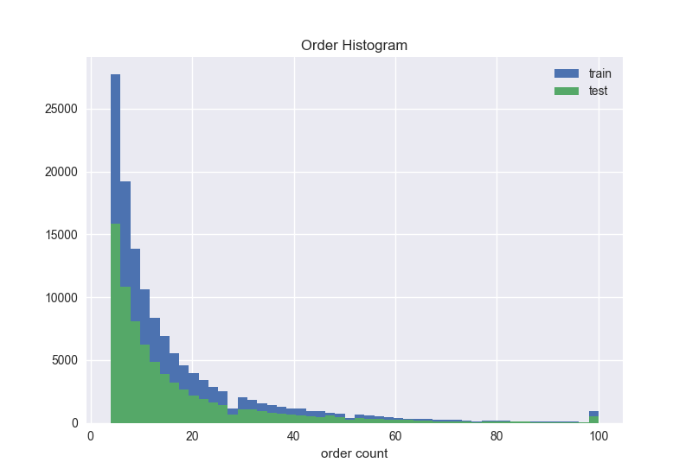
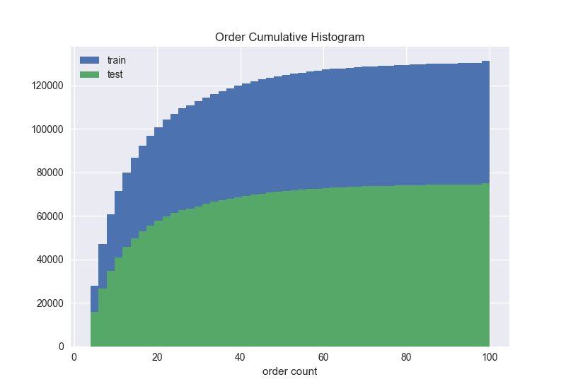
Problem Overview
How hot(user)?
*prior is regarded as train

Slide 6
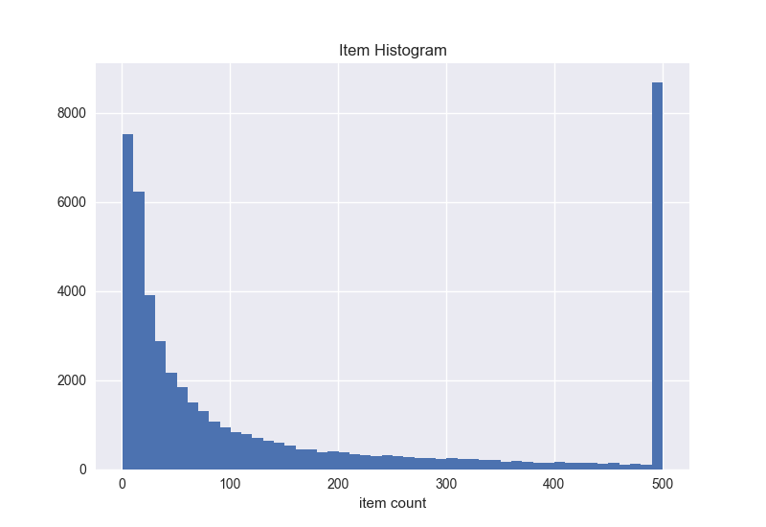
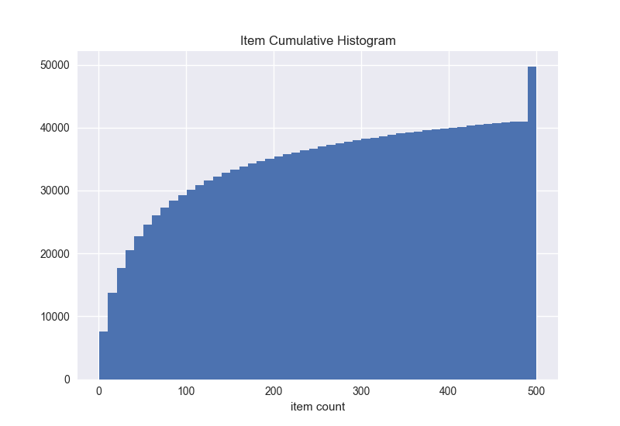
Problem Overview
How hot(item)?
*Clipped by 500

Slide 7
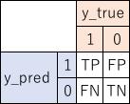
Problem Overview
Evaluation metric is mean F1 score
Precision and Recall

Slide 8
Problem Overview
Links between the files

Slide 9
Main Approach
I made 2 models. For predicting reorder and for predicting None*
reorder model’s keys are user_id and product_id
None model’s key is only user_id
I thought I should use more train data to make better prediction
I decided to use prior as train
As a result of tunings, best number of window is 3
See next page for details
*None means there is no reorder

Slide 10
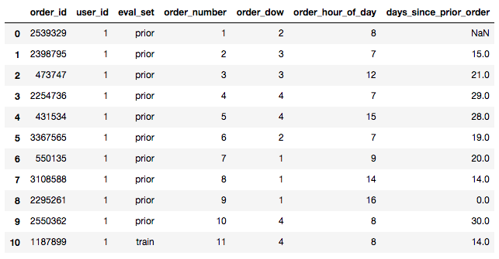
Main Approach
We are given orders.csv

Slide 11
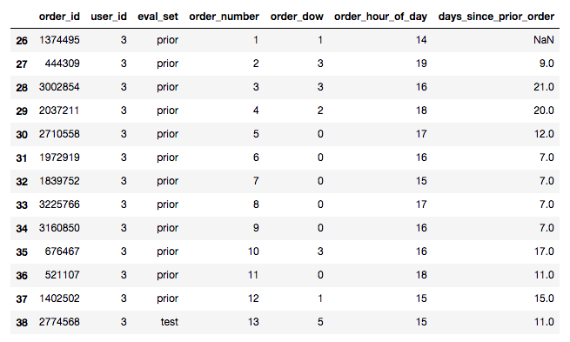
Main Approach
We are given orders.csv

Slide 12
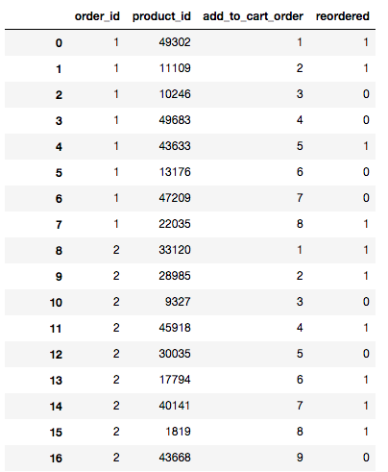
Main Approach
We are given order_products.csv

Slide 13
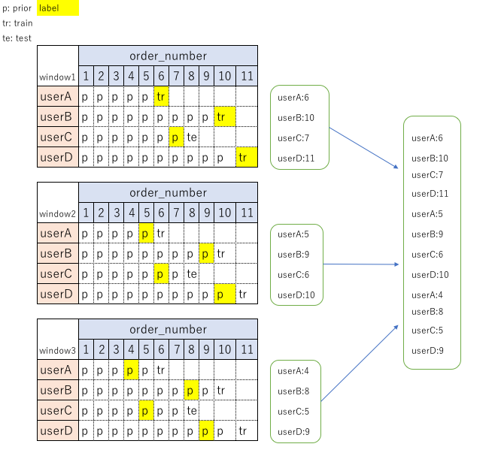
Main Approach

Slide 14
Feature Engineering
I made 4 types of features
User
What this user like
Item
What this item like
User x Item
How do the user feel about the item
Datetime
What this day and hour like
*For None model, I can’t use above features except user and datetime. So I convert those to stats(min, mean, max, sum, std…).

Slide 15
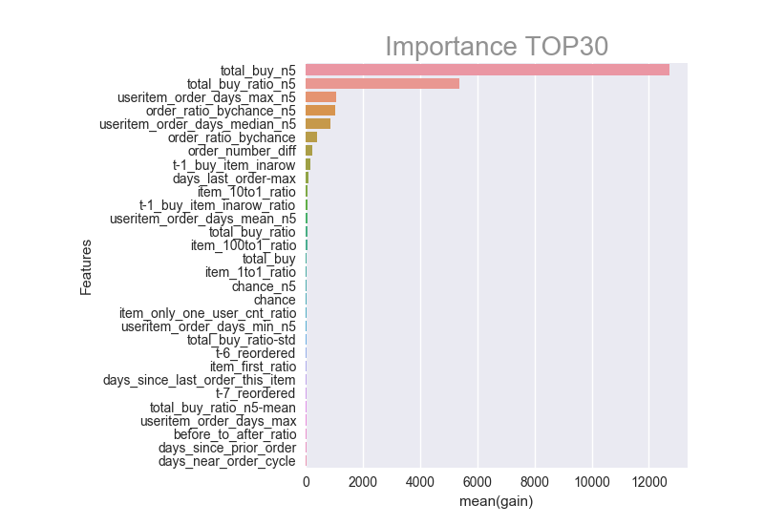
Feature Importance for reorder

Slide 16
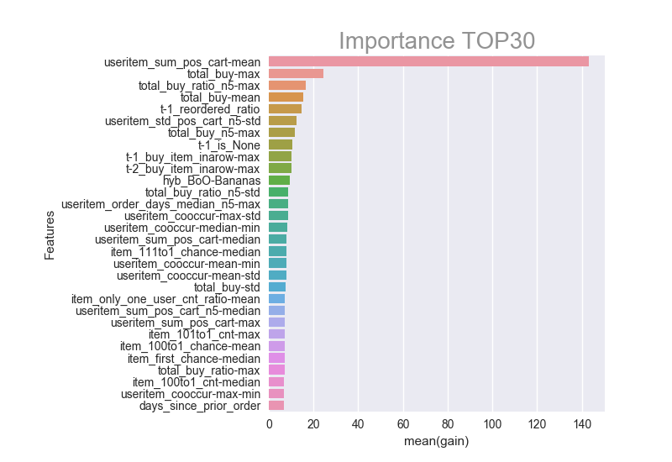
Feature Importance for None

Slide 17
Important Findings for reorder - 1
Common sense tells me the item bought many times has high probability for reordering
Although the user bought the item many times, there is a timing for not reordering
I could figure out why the user didn’t buy the item
See next page for details

Slide 18
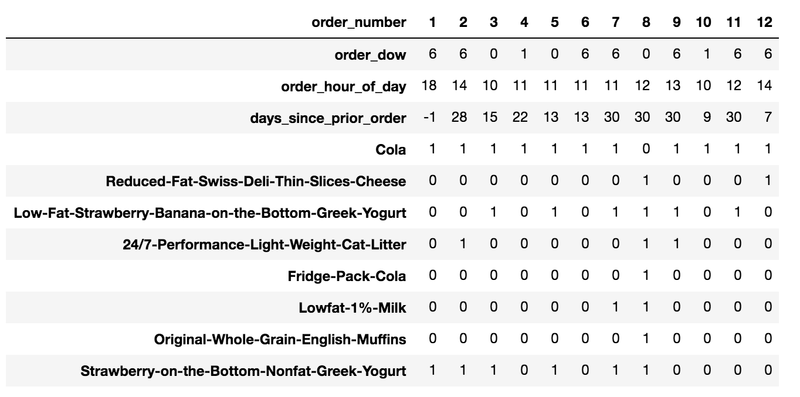
Important Findings for reorder - 1
user_id: 54035

Slide 19
Important Findings for reorder - 1
This user always reorder Cola
But at the order_number=8, the user didn’t reorder Cola
Why didn’t the user reorder Cola?
I guess the user bought Fridge Pack Cola in stead of Cola
Therefore I made some features to catch that

Slide 20
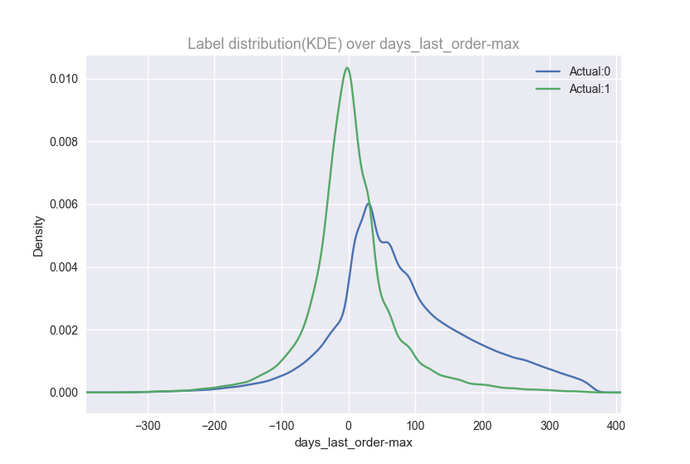
Important Findings for reorder - 2
See this feature

Slide 21
Important Findings for reorder - 2
days_last_order-max is difference between days_since_last_order_this_item and useritem_order_days_max
days_since_last_order_this_item is a feature belong to user and item. This means how many days passed since last order
Also, useritem_order_days_max is a feature belong to user and item. This means max span(day) of order
For more detail, see the next page

Slide 22
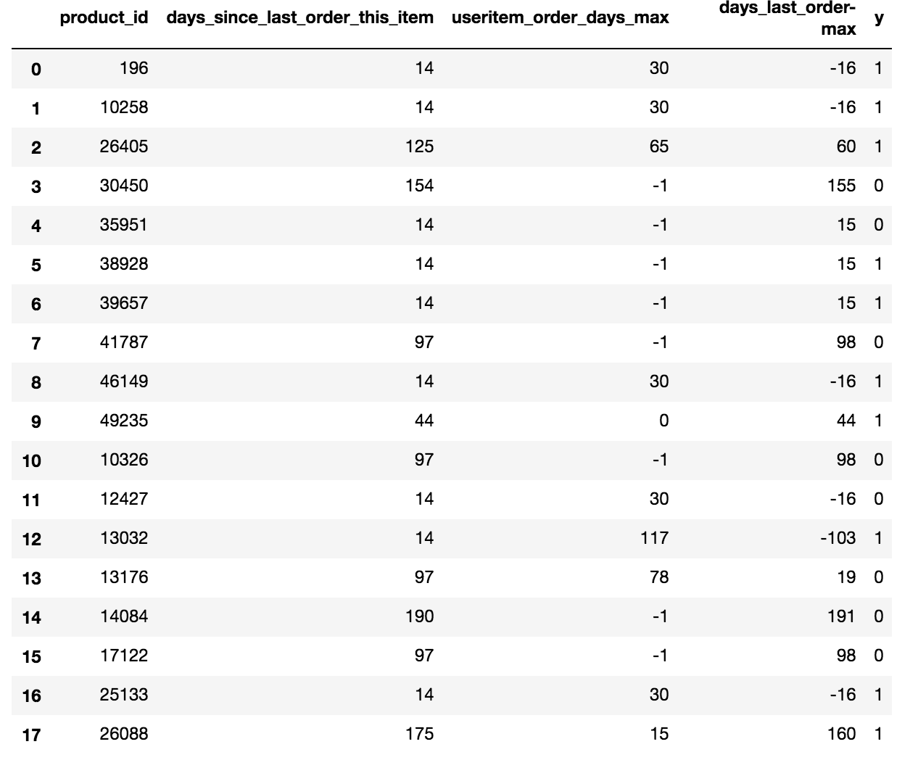
Important Findings for reorder - 2
See the index 0, this means
the user bought this item 14 days
ago, and max span is 30 days
So I think this feature says if the user
is bored or not by that item

Slide 23
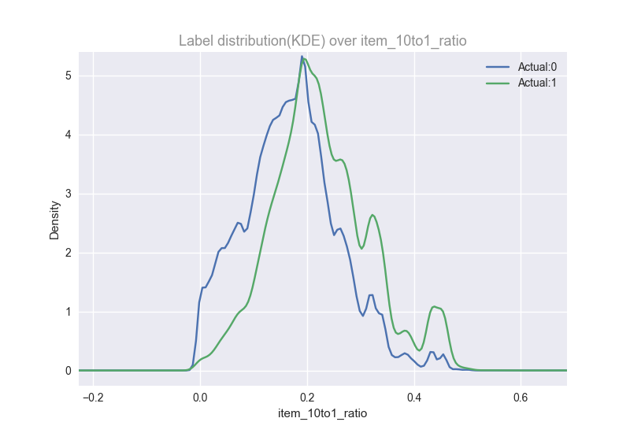
Important Findings for reorder - 3
We already know fruits are reordered more frequently than vegetables(3 Million Instacart Orders, Open Sourced)
So I’d like to know how often?
And made this feature
This item_10to1_ratio means what’s
the reorder ratio after ordered(1)
and not ordered(0)
Next page, for more details

Slide 24
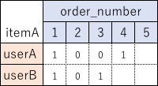
Important Findings for reorder - 3
Lets say userA bought itemA at order_number 1 and 4
And userB bought itemA at order_number 1 and 3
item_10to1_ratio is 0.5

Slide 25
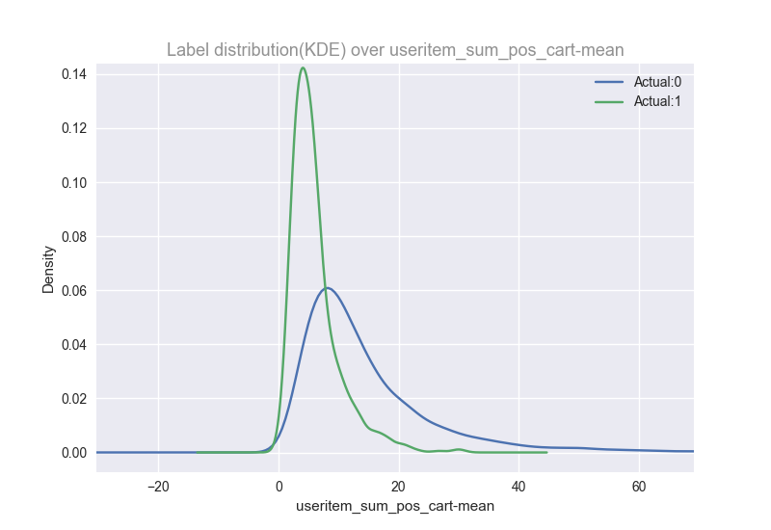
Important Findings for None - 1
useritem_sum_pos_cart is made by summing up the pos_cart by user and item
So useritem_sum_pos_cart-mean
is mean of above by user
This feature says the user who didn’t
buy many items all at once would be
None

Slide 26
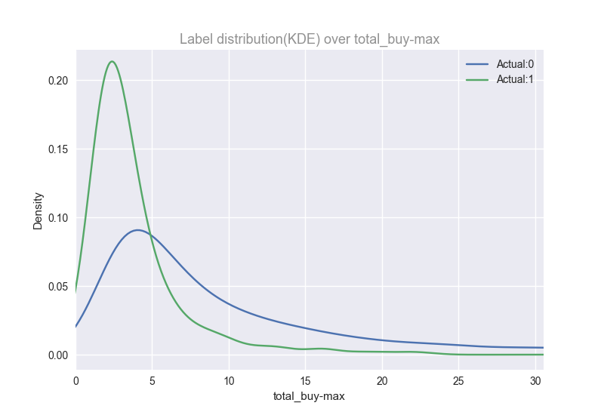
Important Findings for None - 2
total_buy is number of total order
If userA bought itemA 3 times
in the past, this would be 3
So total_buy-max is max of above
feature by user
This feature says the user who bought
same item in the past wouldn’t be None

Slide 27
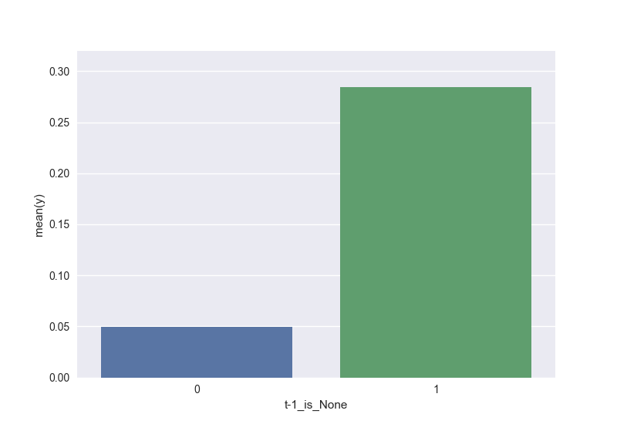
Important Findings for None - 3
t-1_is_None is binary feature
This says if the user’s previous order
is None
If previous order was None,
the next order would be None
with a 30% possibility

Slide 28
F1 maximization
In this competition, F1 score were used
So we needed to convert probability to binary
To convert, we also needed to know the threshold
At first, I used 0.2 as threshold that was optimized by grid search
But I saw the comment on discussion that said different order should have different threshold
See the next page

Slide 29
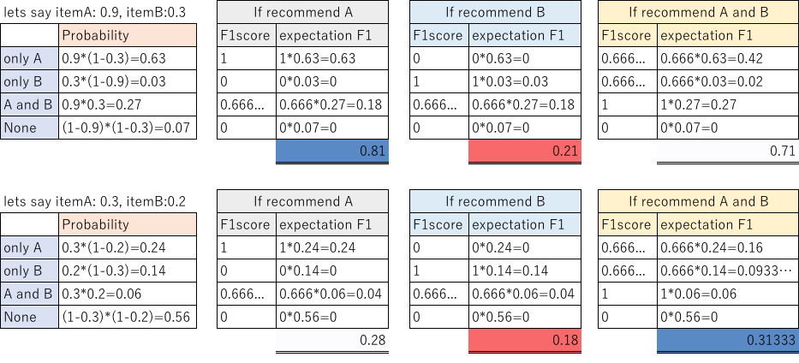
F1 maximization

Slide 30
F1 maximization
In the first example, threshold is between 0.9 and 0.3
In the second example, threshold is lower than 0.2
As I showed, each order should have each threshold
But using above calculation, we have to prepare all patterns of probability at first
Thus I needed to come up with another calculation
See the next page

Slide 31
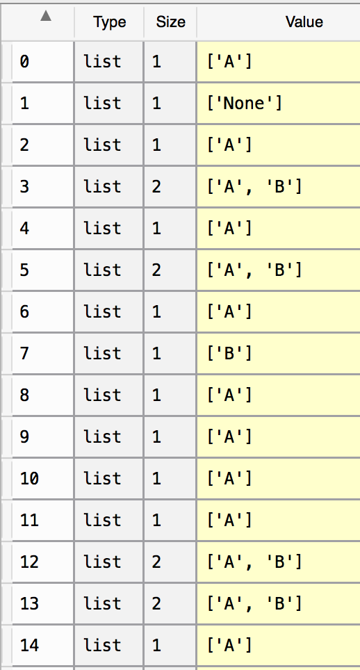
F1 maximization
Lets say itemA:0.9, itemB:0.3
I generated pseudo y_true using randomness
many times
And then checked F1 score from
higher probability item until F1 score
get worse
We don’t need to calculate all of patterns
like A, B, AB…
Because if we should select itemB, we should
select itemA as well

Slide 32
F1 maximization
F1score_mean( , [A]) -> 0.809747641431
F1score_mean( , [A,B]) -> 0.709004233757

Slide 33
F1 maximization
In that method, None is probability of (1-itemA)*(1-itemB)*…
But I thought None can be predicted
Thus I made None model and handling None as item, got high score
This finding boost F1 0.400 to 0.407

